Slide 1


HELOC LOAN
DECISION
SUPPORT
SYSTEM
A Machine Learning Approach for
Automating Credit Decisions
Team members:
Shan Ali Shah Sayed | Godwin Silayo | Syed Ibnul Haq | Fangdi Hou | Yichen Yao

Slide 2

INDEX
Problem Statement
Dataset and Preprocessing
Model Selection and Training
Model Performance Metrics
Result Analysis
Prototype
Deployment and Monitoring
Conclusion and Future Work

Slide 3

PROBLEM STATEMENT
Manual loan screening is time-consuming & costly.
Risk assessment is subjective and inconsistent.
Delayed approvals lead to poor customer experience.
Goal: Automate loan screening using machine learning while ensuring fair, explainable, and efficient decisions.

Slide 4


DATASET
HELOC applications
with 23 financial variables
DATASET & PREPROCESSING
KEY STEPS IN DATA PREPROCESSING
Mapped Risk Performance variable (Good = 1, Bad = 0).
Dropped -9 values (No Bureau Record).
Imputed -8 and -7 using median values.

Slide 5


MODEL EVALUATED
Logistic Regression
Decision Tree
Gradient Boosting
Random Forest (Final Selection)
MODEL SELECTION & TRAINING
CHOSEN MODEL: RANDOM FOREST
HIGHEST PRECISION (0.72)
Balanced Accuracy & AUC-ROC (0.72)
Interpretability & Robustness

Slide 6
Model Performance Metrics
Model | Accuracy | Precision | Recall | F1 Score | AUC-ROC
Logistic Regression | 0.72 | 0.72 | 0.68 | 0.70 | 0.72
Decision Tree | 0.64 | 0.61 | 0.61 | 0.61 | 0.63
Random Forest | 0.72 | 0.73 | 0.67 | 0.69 | 0.72
Gradient Boosting | 0.72 | 0.72 | 0.68 | 0.70 | 0.72

Slide 7
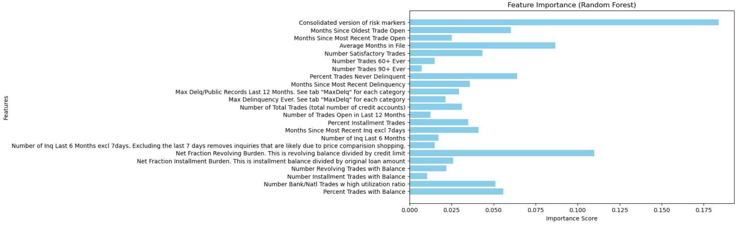
EXPLANATION METHODS
(SHAP Analysis)
Number of Inquiries in Last 6 Months
Months Since Most Recent Trade Open
Average Months in File
MARKET OPPORTUNITY
INDUSTRY TREND
Environmentally friendly
Sustainable Products

Slide 8


STREAMLIT PROTOTYPE
User-friendly tool
Predicts approval or denial
in real-time
SHAP Visualization explains
model decisions
LINK

Slide 9

Regular Model Retraining with
new application data
DEPLOYMENT & MONITORING
Bias & Fairness Audits to ensure
ethical decision-making
Performance Monitoring to track precision & recall

Slide 10

CONCLUSION & FUTURE WORK
Dataset & Goal
Used 10,000 HELOC applications to train ML models for automated loan screening.
Model Selection
Random Forest chosen for best precision (0.7240), accuracy (0.7177), and interpretability.
Prototype
Built a Streamlit app for real-time loan decisions with SHAP-based explanations.
Challenges
Improving model accuracy and optimizing feature selection.
Future Data Collection
Gather new data and loan officer feedback for continuous improvement.

Slide 11



THANK YOU
Q&A

